Slide 1
Mars Orbiter Landing using RL Group #27
Wenjun, Ishan, Tamoghna
May. 01, 2019

Slide 2
Presentation Outline
1. Introduction
2. Deep Q-Learning
3. Policy Gradient
4. Actor Critic
5. Conclusion
Notes:
Introduction :
* background
* motivation
* innovation

Slide 3
Introduction – Motivation
Inspired by Space X Falcon Rocket Retrieval
Understand and Explore RL Algorithms in more detail
AI is the future and we want to get onboard !
Introduction | 1
Notes:
* RL – defines the objective
* DL – gives the mechanism
* DRL – general intelligence

Slide 4
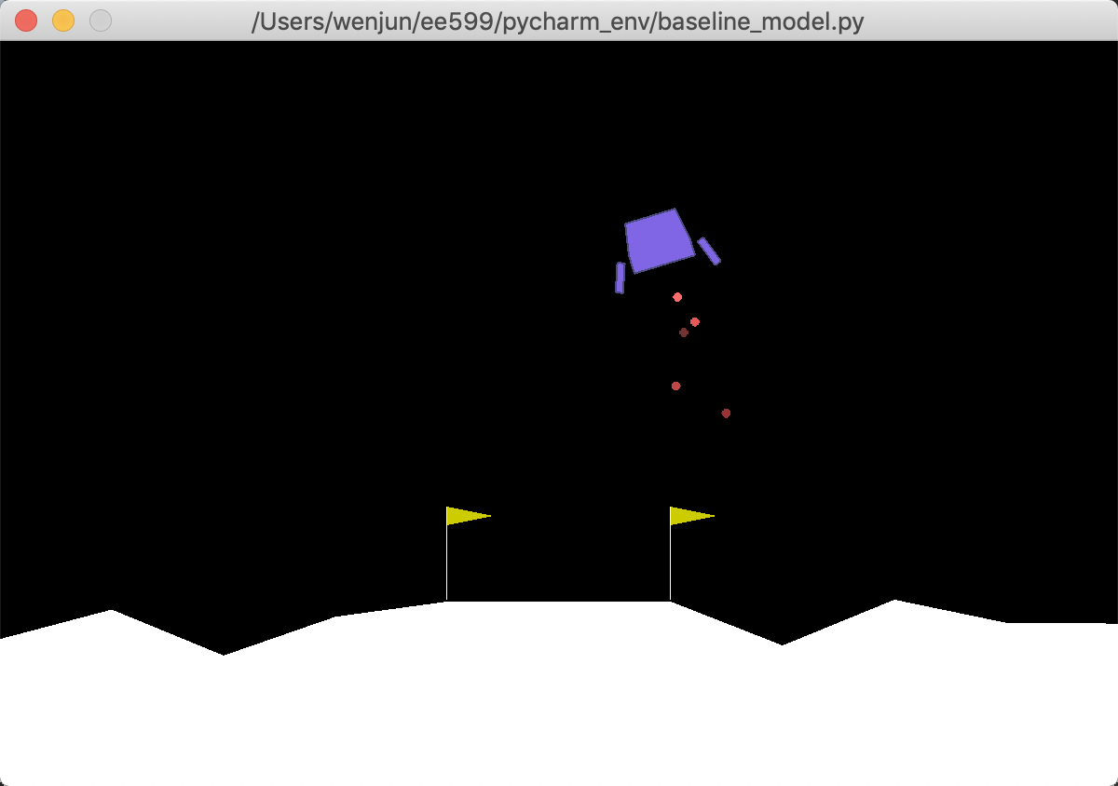
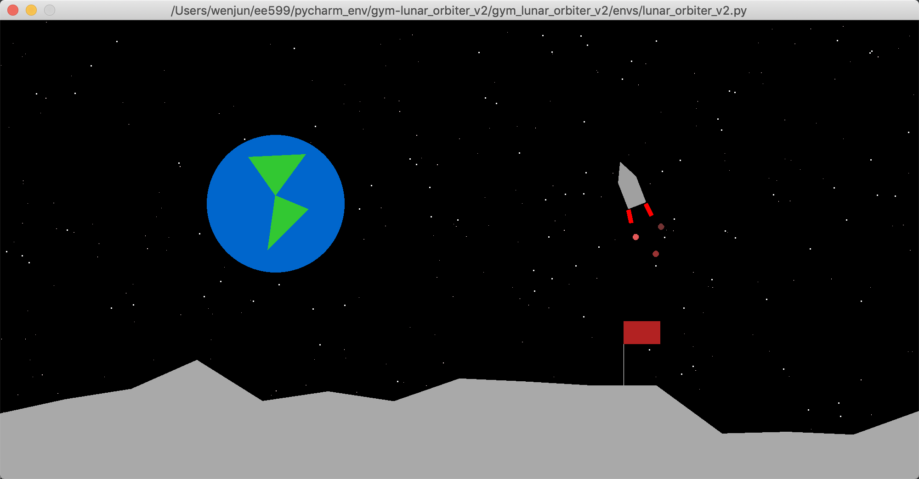
Introduction – Innovation
New Environment
original env – LunarLander-v2
new env – Lunar Orbiter
Introduction | 2
Notes:
The original env is from OpenAI gym
* so, our project is not only python coding and RL algorithm understanding, it also involves understanding gym and Box2D,
* which is an 2D physical game engine
The decoration is not easy to code,
* we put on stars, earth -> let it to be more realistic
* we changed the rocket ship, which has () legs, even more difficult to land
* change the shape of the flag

Slide 5
Introduction – Innovation
Action variables – a[4]
a[0] – do nothing
a[1] – left engine
a[2] – main engine
a[3] – right engine
State variables – s[8]
s[0] -- x distance
s[1] – y distance
s[2] – x velocity
s[3] – y velocity
s[4] – angle
s[5] – angular velocity
s[6] – left leg contact
s[7] – right leg contact
Reward variables – r[~]
engine firing
leg contact
position, linear velocity
angle, angular velocity
solved
crash
Introduction | 3
Notes:
The original env is from OpenAI gym
* so, our project is not only python coding and RL algorithm understanding, it also involves understanding gym and Box2D,
* which is an 2D physical game engine
The decoration is not easy to code,
* we put on stars, earth -> let it to be more realistic
* we changed the rocket ship, which has () legs, even more difficult to land
* change the shape of the flag

Slide 6
Introduction – Innovation
Project Challenges
Parameters | Old Env | New Env
Flag position | Always in the middle, wide platform | Random position, could be close to the boundary
Terrain | Less chunks and less slopes | More chunks and more slopes, larger slope angle
Rocket shape | Lower gravity center and larger leg angles => more stability | Higher gravity center and smaller leg angles => Less stability
Reward function and DRL algorithms | Easy reward function | Original reward function doesn’t work in new env. Designed own reward function
Introduction | 4
Notes:
1. 我

Slide 7
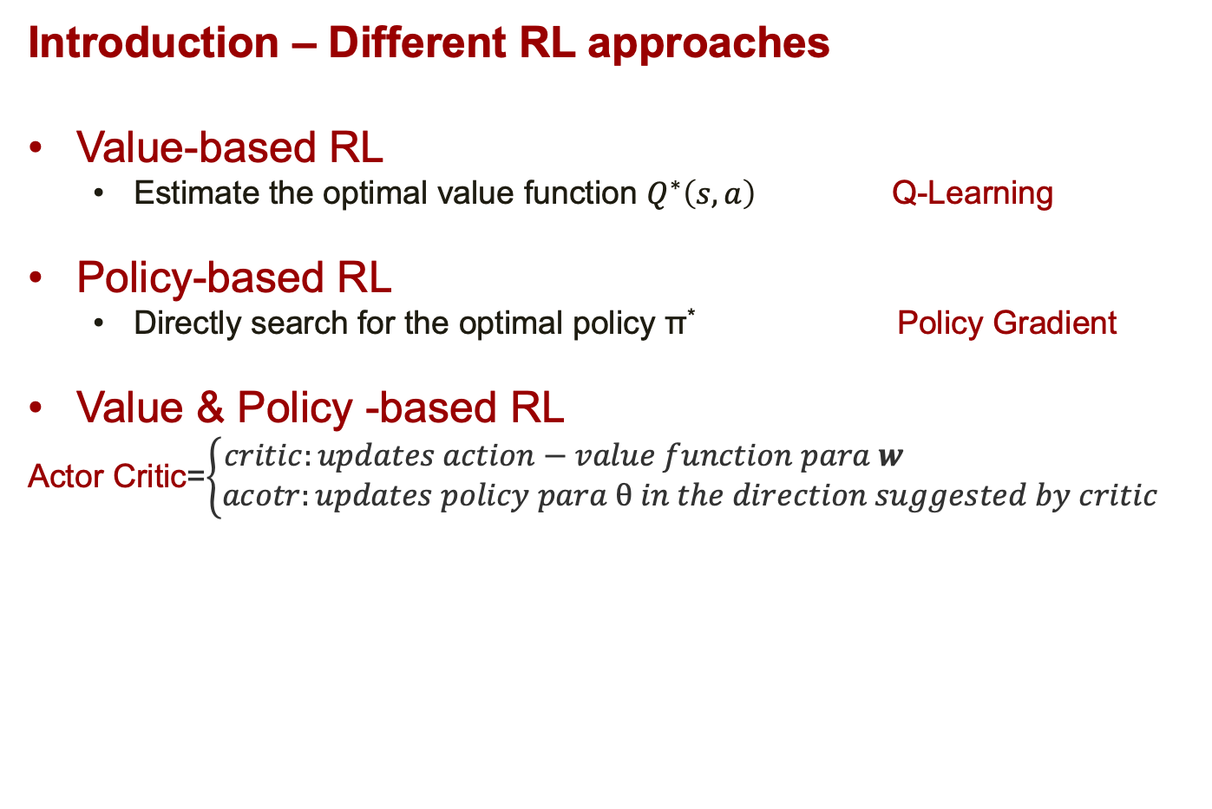
Introduction – Different RL approaches
Value-based RL
Estimate the optimal value function $Q^{∗}\left(s, a\right)$ Q-Learning
Policy-based RL
Directly search for the optimal policy π* Policy Gradient
Value & Policy -based RL
Actor Critic=$\left\{\begin{aligned}critic:updates action−value function para w \\ acotr:updates policy para θ in the direction suggested by critic\end{aligned}\right.$
Introduction | 5

Slide 8
Q-Learning
Notes:
Why better convergence properties?
* if you do value-function in a wrong way, it will chatter/oscillate;
* stick to policy gradient, incrementally improve your policy little by little, it always converge. Guaranteed to converge at least at local optima
Why in high-dimensional difficult? --- this probably the no.1 reason to use Policy Gradient
* hard to compute value function and find max in high-D
* you have to figure out how to compute the maxima of Q-function, maximize Q over a. so, you choose to pick the a which lead to maximal Q; but what is you have a trillion actions to pick (or, in a continuous space), which is prohibitively expensive.
接上句，while if you use PG, you can understand and improve your policy step by step, and finally you achieve the optimal
2. Why stochastic policy?
* deterministic policy can be easily exploited
* in the case of state aliasing where we don’t have access to the full MDP,
stochastic policy works better than deterministic
4. some examples:
*

Slide 9
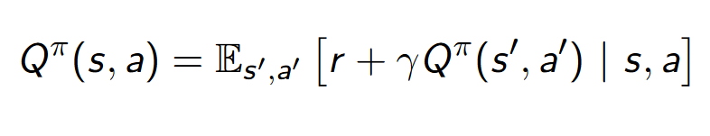
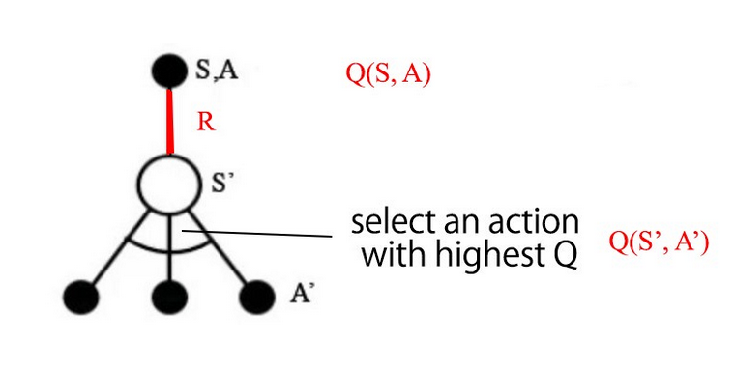
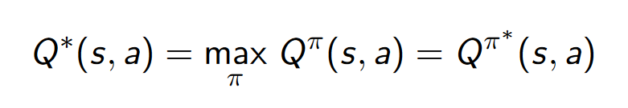
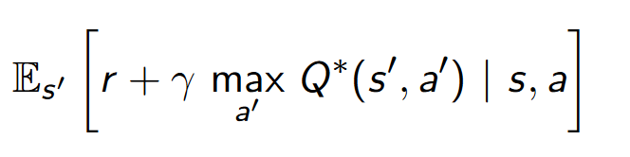
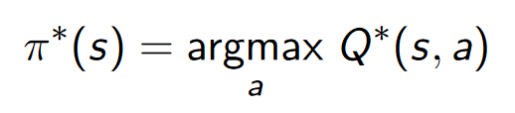
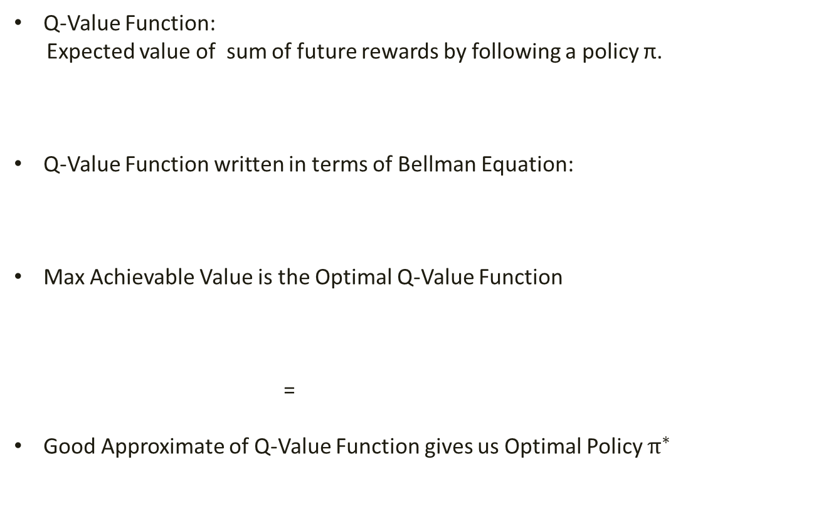
What is Q-Learning ?
Q-Value Function:
Expected value of sum of future rewards by following a policy π.
Q-Value Function written in terms of Bellman Equation:
Max Achievable Value is the Optimal Q-Value Function
=
Good Approximate of Q-Value Function gives us Optimal Policy $π^{∗}$
Q-Learning | 1

Slide 10
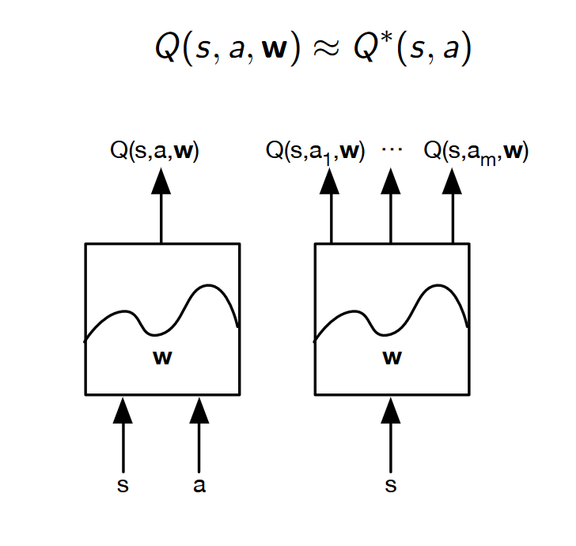
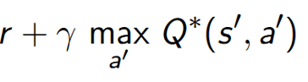
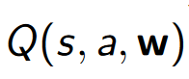
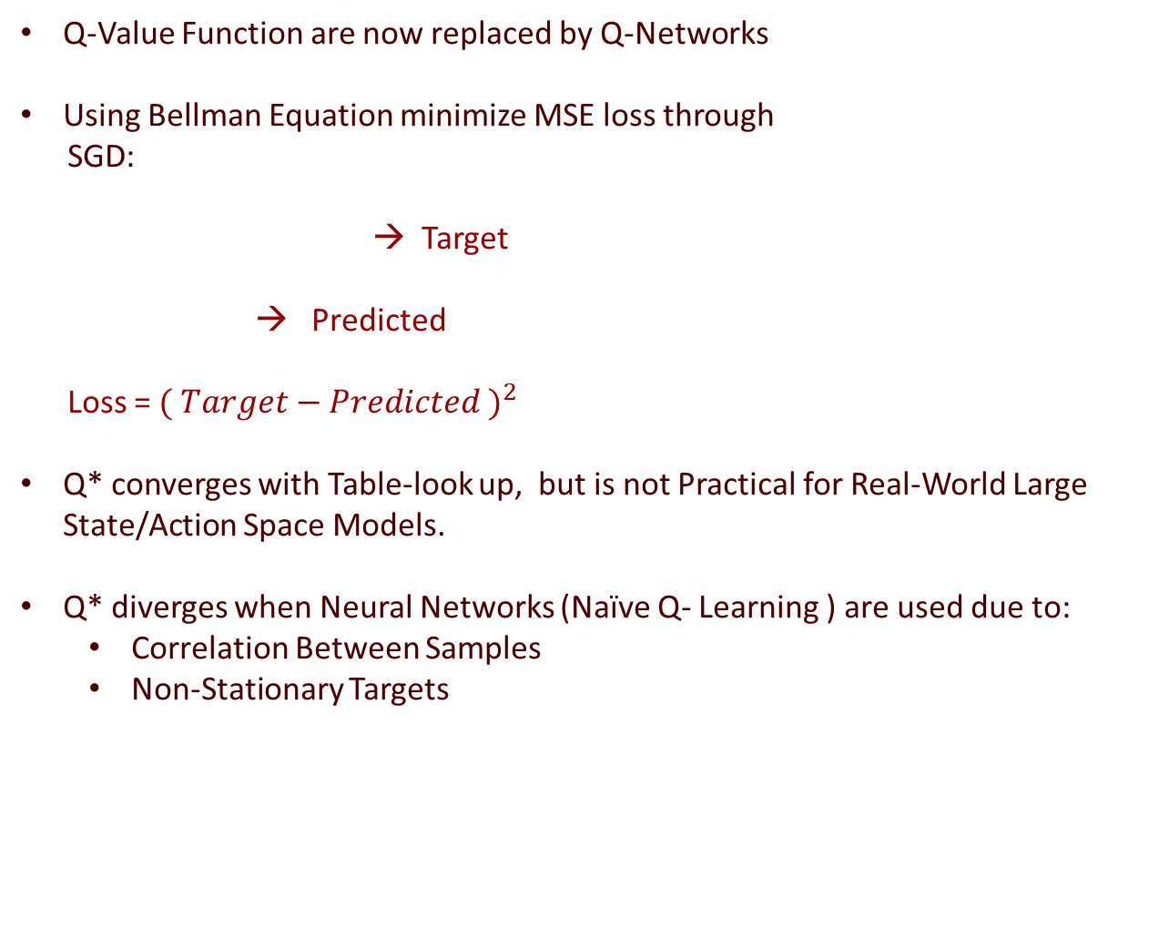
Q-Value Function are now replaced by Q-Networks
Using Bellman Equation minimize MSE loss through
SGD:
→ Target
→ Predicted
Loss = ${( Target−Predicted )}^{2}$
Q* converges with Table-look up, but is not Practical for Real-World Large State/Action Space Models.
Q* diverges when Neural Networks (Naïve Q- Learning ) are used due to:
Correlation Between Samples
Non-Stationary Targets
Q-Learning | 2

Slide 11
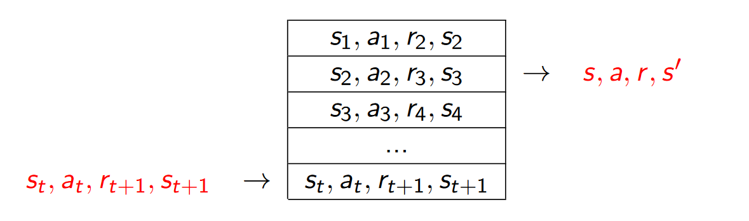
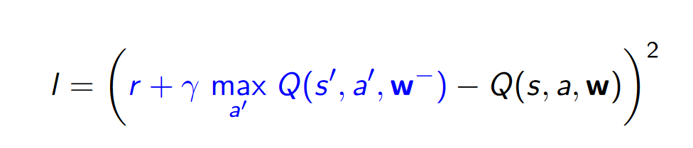
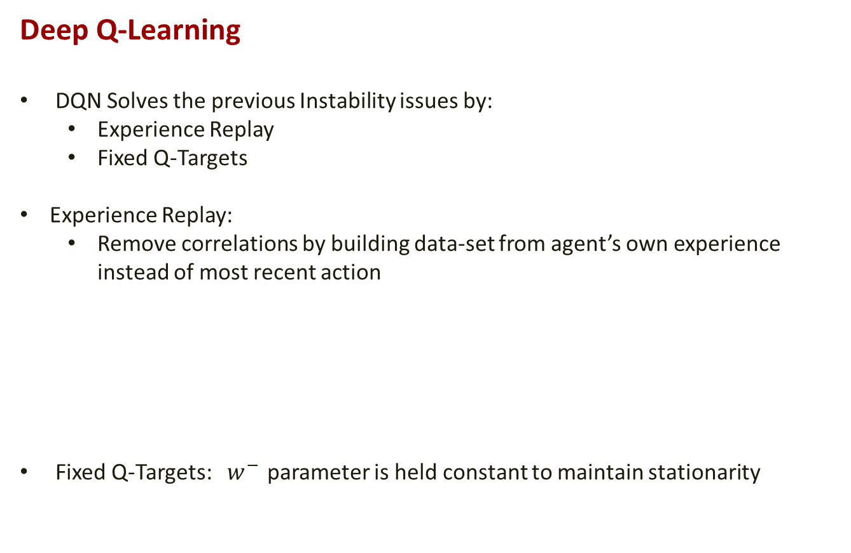
Deep Q-Learning
DQN Solves the previous Instability issues by:
Experience Replay
Fixed Q-Targets
Experience Replay:
Remove correlations by building data-set from agent’s own experience instead of most recent action
Fixed Q-Targets: $w^{− }$parameter is held constant to maintain stationarity
Q-Learning | 3

Slide 12
DQN Algorithm
Init Empty
Replay Memory
Init DQN with random weights
Add S,A,R,S’ to Replay Memory
Choose Action A in State S using Є-greedy Algo
Receive Reward R(S,A)
Observe New State S’
Not Converge then Repeat
Sample Mini-Batch of
S,A,R,S’
Perform SGD on Loss Function
Terminal State
Converges
Q-Learning | 4

Slide 13
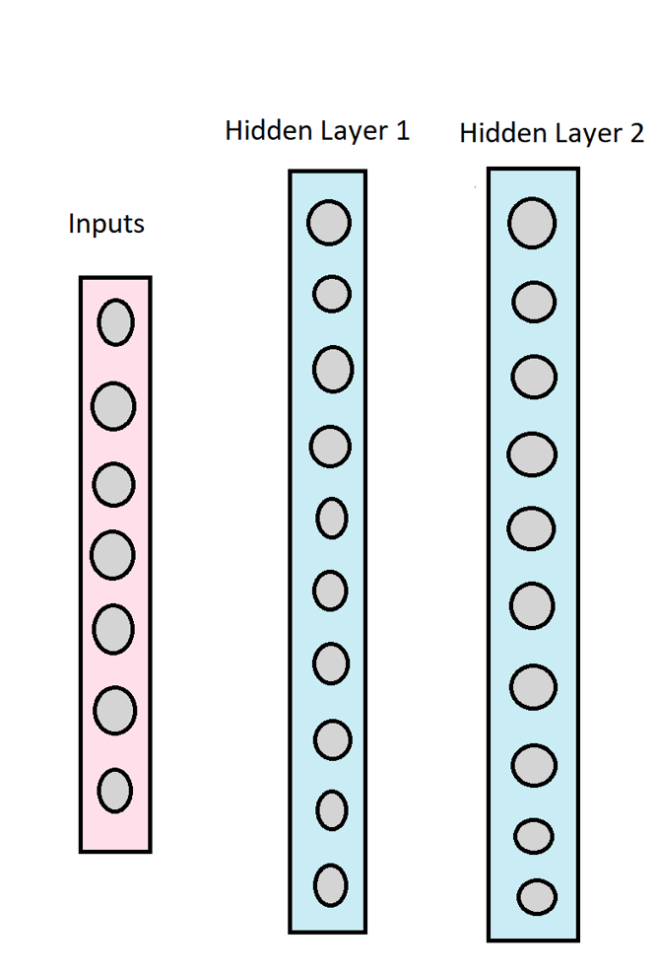
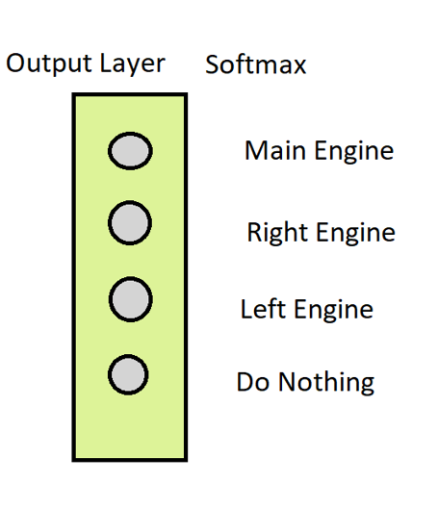
DQN Model Architecture
(8,1) (64,8) (64,64) (4,64)
Q-Learning | 5

Slide 14
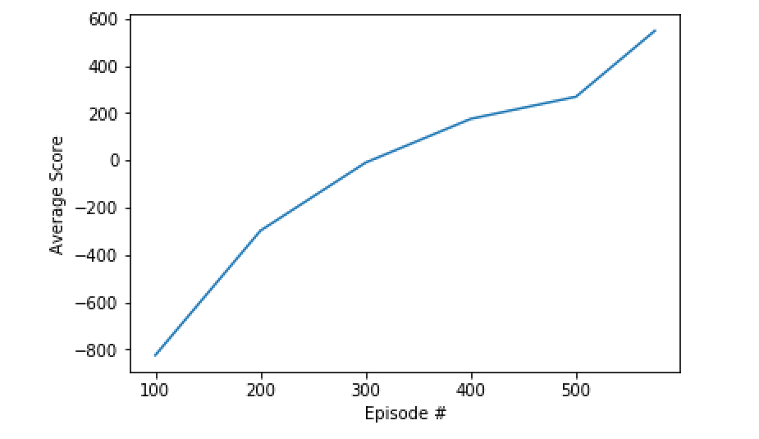
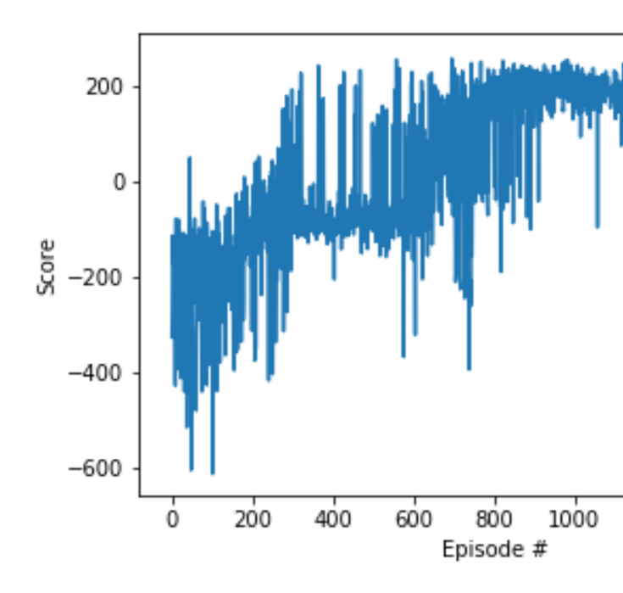
DQN Training Results
Landing Performance Video: https://www.youtube.com/watch?v=V3I30vjILuQ
Episodic Convergence:
Average Reward per 100 episodes vs Reward per Episode until Convergence
Q-Learning | 6

Slide 15
Shortcomings of DQN
Complex Q-Value Function Leads to Bad Performance as they cannot be learnt easily.
Does not work that well for stochastic policies and continuous action space environments.
Q-Learning | 7

Slide 16
Policy Gradient
Notes:
Why better convergence properties?
* if you do value-function in a wrong way, it will chatter/oscillate;
* stick to policy gradient, incrementally improve your policy little by little, it always converge. Guaranteed to converge at least at local optima
Why in high-dimensional difficult? --- this probably the no.1 reason to use Policy Gradient
* hard to compute value function and find max in high-D
* you have to figure out how to compute the maxima of Q-function, maximize Q over a. so, you choose to pick the a which lead to maximal Q; but what is you have a trillion actions to pick (or, in a continuous space), which is prohibitively expensive.
接上句，while if you use PG, you can understand and improve your policy step by step, and finally you achieve the optimal
2. Why stochastic policy?
* deterministic policy can be easily exploited
* in the case of state aliasing where we don’t have access to the full MDP,
stochastic policy works better than deterministic
4. some examples:
*

Slide 17
Policy Gradient
Why we need to learn policy directly?
Better convergence properties
Effective in high-dimensional and continuous environment,
while in such environments, maxima value function (Q) can be
complicated/tricky, while policy can be more straight-forward
Can learn stochastic policies
Policy Gradient | 1
Notes:
Why better convergence properties?
* if you do value-function in a wrong way, it will chatter/oscillate;
* stick to policy gradient, incrementally improve your policy little by little, it always converge. Guaranteed to converge at least at local optima
Why in high-dimensional difficult? --- this probably the no.1 reason to use Policy Gradient
* hard to compute value function and find max in high-D
* you have to figure out how to compute the maxima of Q-function, maximize Q over a. so, you choose to pick the a which lead to maximal Q; but what is you have a trillion actions to pick (or, in a continuous space), which is prohibitively expensive.
接上句，while if you use PG, you can understand and improve your policy step by step, and finally you achieve the optimal
2. Why stochastic policy?
* deterministic policy can be easily exploited
* in the case of state aliasing where we don’t have access to the full MDP,
stochastic policy works better than deterministic
4. some examples:
*

Slide 18
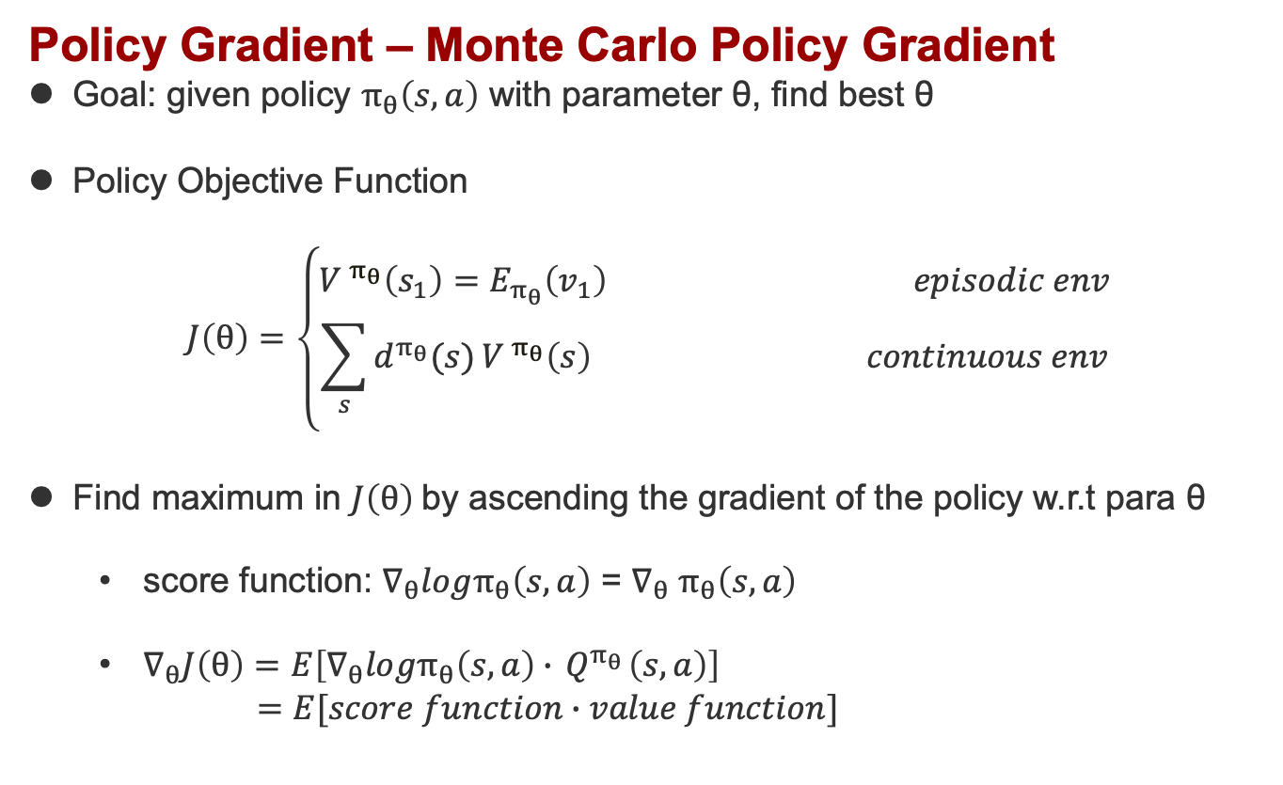
Policy Gradient – Monte Carlo Policy Gradient
Goal: given policy $π_{θ}\left(s, a\right)$ with parameter θ, find best θ
Policy Objective Function
$$J\left(θ\right)=\left\{\begin{aligned}V^{ π_{θ}}\left(s_{1}\right)=E_{π_{θ}}\left(v_{1}\right) episodic env \\ \sum_{s}{d^{π_{θ}}(s)}V^{ π_{θ}}\left(s\right) continuous env\end{aligned}\right.$$
Find maximum in $J\left(θ\right)$by ascending the gradient of the policy w.r.t para θ
score function: $∇_{θ}logπ_{θ}\left(s,a\right)$ = $∇_{θ}$ $π_{θ}\left(s,a\right)$
$∇_{θ}J\left(θ\right)=E\left[∇_{θ}logπ_{θ}\left(s,a\right)∙{ Q}^{π_{θ}}\left(s,a\right)\right]$
$=E[score function∙value function]$
Policy Gradient | 2
Notes:
# Question: how to we measure the quality of a policy $π_{θ}$
in episodic env, we can use the start value
In continuous env, we can use the average value

Slide 19
Policy Gradient – Neural Network
Network
Loss Function
Training Data
saving state, action, reward, … for every step
softmax cross entropy
(logits, labels)
* (discounted episode reward)
optimizer
Policy Gradient | 3

Slide 20
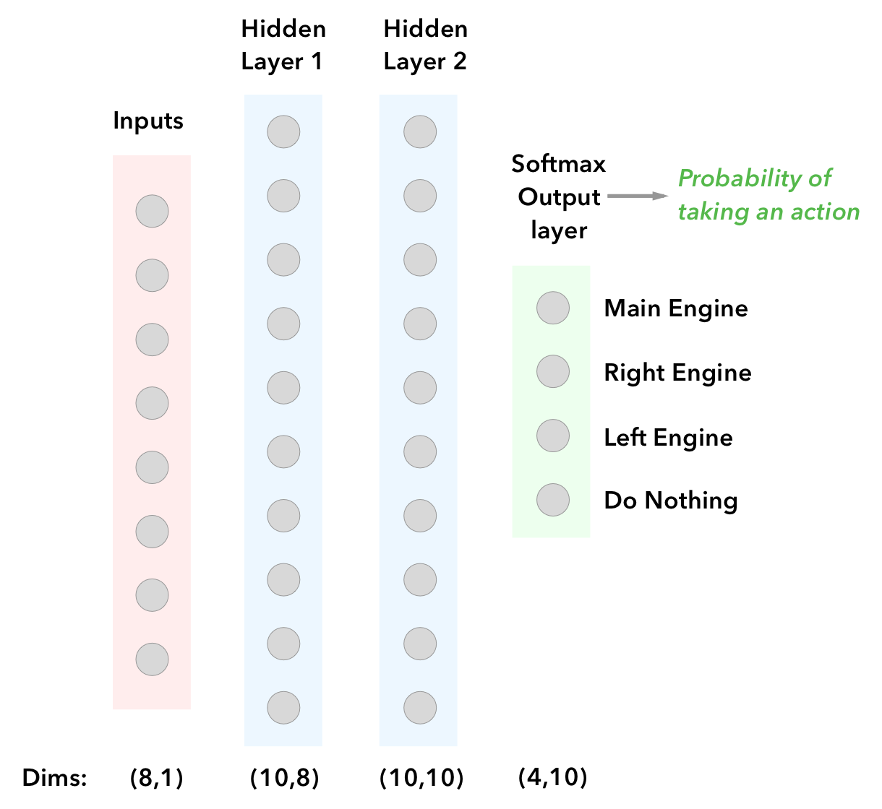
Policy Gradient – Neural Network Structure
Policy Gradient | 3
Notes:
1. 我

Slide 21
Policy Gradient – Algorithm Flow Chart
get the state[8]
feed forward to predict action
get reward and next state_[8]
saving transition: state, action, reward
repeat until 'done'
if 'done', train DNN to learn from stored transitions
Policy Gradient | 4
Notes:
1. 我

Slide 22
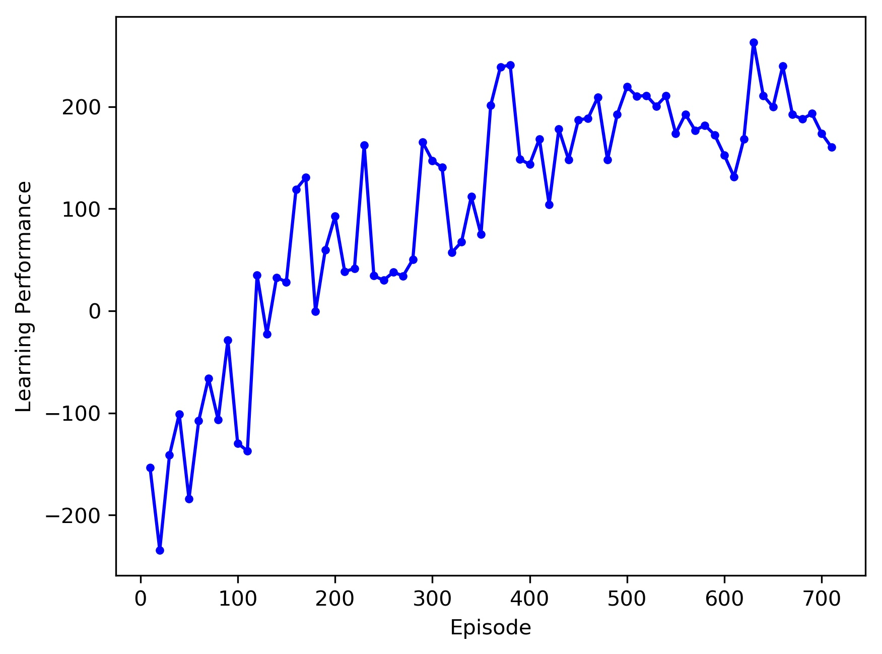
Policy Gradient -- Results
Landing video:
At the beginning of training: video1
After 200 episodes: video2
After 500 episodes: video3
Why failures happen: analysis video
Plots:
Policy Gradient | 5
Notes:
1. 我

Slide 23
Policy Gradient -- Disadvantages
Typically converge to local optima rather than global optima, while value-based algorithm always converges to global optimum
Evaluating a policy is sometimes inefficient and high-variance
Policy Gradient | 6
Notes:
1.Why value-based always converge to global optima?
* because it use max method, very aggressive
2.Why slow, inefficient?
* when you use argmax/max, you are very aggressive, so, you next step absolutely lead you to better result, you learn quickly
* while in PG, you move smoothly and take a small step every time.

Slide 24
Asynchronous Advantage Actor Critic Algorithm
A3C | 1

Slide 25
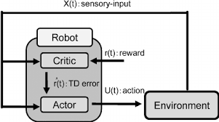
A3C - Introduction
Developed in Google Deep Mind.
On previous built environments, takes less time for training and gives better results.
Consists of three important parts:
1. Actor – Critic
2. Asynchronous
3. Advantage
A3C | 2

Slide 26
A3C - Actor Critic
The model has two outputs :
1. A set of outputs which indicate possible actions e.g., Q(s,a1) . It’s called actor or Policy(s).
2. A separate value V(s) which indicates value of the state. This is called critic.
So, basically two neural networks : an ‘actor’ to determine optimal action and a ‘critic’ to estimate the potential reward of the action.
A3C | 3

Slide 27
A3C - Asynchronous
Multiple agents attack the environment at the same time. They are initialized differently and hence called asynchronous.
More experience due to multiple agents.
Reduces chances of agent getting stuck in local maximum.
The agents share experience through critic. Thus, V(s) is common for all agents and calculated through rewards from environment.
Agents adjust their neural network as they go forward to better match the expected value of V(s).
Improvement : One Network shared between all agents to give directions/outputs to all the actors.
A3C | 4

Slide 28
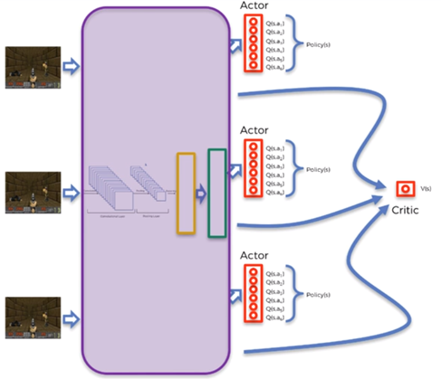
A3C | 5

Slide 29
A3C - Advantage
There are two losses:
1. Value Loss related to V(s).
2. Policy Loss related to Q(s,a1).
Comparing actual value of V(s) with network produced value gives value loss.
Value Loss is backpropagated through the network to update the weights.
For Policy Loss,
Advantage (A) = Q(s, a) – V(s)
Here,
Q(s, a) = Q Value of the action we chose to play to reach current state
V(s) = Value of the state (as shared, so for all agents)
A is used to calculate the policy loss which is then backpropagated and weights are adjusted in such a way that A is maximized.
A3C | 6

Slide 30
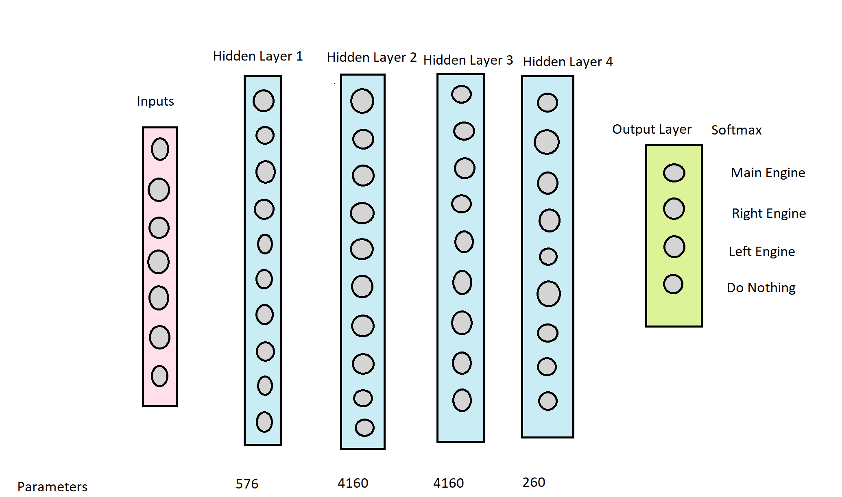
Actor Model
A3C | 7

Slide 31
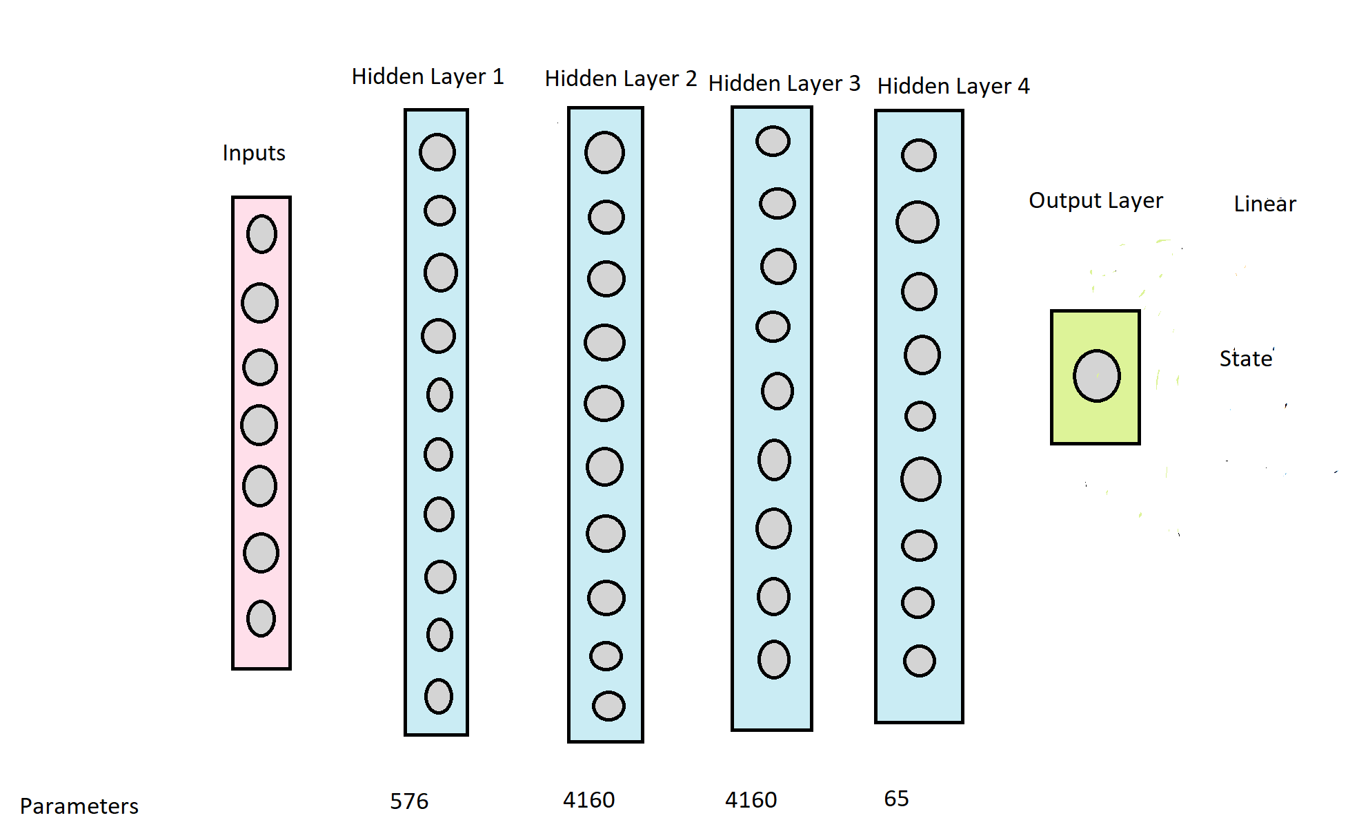
Critic Model
A3C | 8

Slide 32
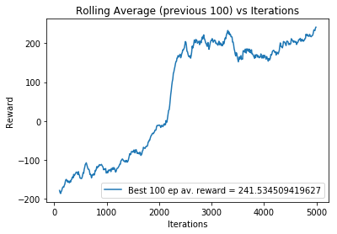
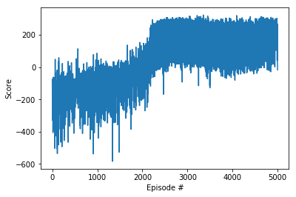
Output Plot
A3C | 9

Slide 33
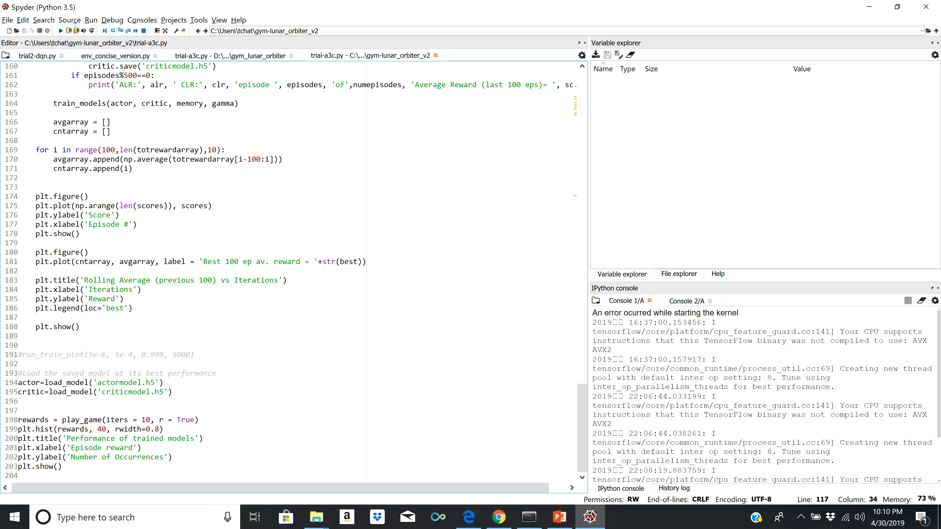
A3C | 10

Slide 34
A3C - Conclusion
In A3C each agent talks to the global parameters independently, so it is possible sometimes the thread-specific agents would be playing with policies of different versions and therefore the aggregated update would not be optimal.
This is the case seen here, where the algorithm performs worse than the other two algorithms.
This is mainly because the environment keeps changing the position of the flag at each iteration.
As a result, the different versions have different policies which make learning difficult.
A3C | 11

Slide 35
Conclusion – Comparison
RL algorithms | Episode Convergence | Average Landing Performance
Q-Learning | 550 episodes | 30/50
Policy Gradient | 600 episodes | 35/50
Actor Critic | 3000 episodes | 25/50
Conclusion | 1

Slide 36
THANK YOU !

